Slide 1
Physics 4 – March 12, 2020
P3 Challenge – Indicate the decay series for ${}_{84}^{218}{Po}$. Use the table of nuclides and report your answer in the format:
${}_{92}^{238}U$ → ${}_{90}^{234}{Th}$ → ${}_{91}^{234}{Pa}$ … until stable

⁻
Get out 16, 17 and 23 for HMK check
And Hand in the 7.1 Radioactivity Lab

Slide 2
Objectives/Agenda/Assignment
Objective:
7.2 Nuclear Applications
Assignment:
p294 #18-24, except 23
And Worksheet 6-8
Agenda:
Nuclear reactions
Fission
Fusion
Energy from nuclear reactions

Slide 3
Nuclear decays as nuclear reactions
The simplest type of nuclear reaction is a nuclear decay that is associated with the loss of an alpha or beta particle, like those we have written.
These are all exothermic processes and release energy.
The energy released comes from a loss of mass.
m = reactants – products
E = mc² or in Mev E = m*931.5 MeV

Slide 4
Induced Transmutation
We can also induce nuclear reactions by bombarding nuclei with neutrons, protons, alpha particles or other particles including small atoms like oxygen.
This is the purpose of a cyclotron.
These nuclear reactions follow the same rules as nuclear decay processes.
Ex: Alumunim-27 reacts with alpha particles to produce a neutron and another element.

Slide 5
Nuclear Fission
In 1939, Lise Meitner and Otto Hahn discovered that when Uranium 235 is bombarded with neutrons a nuclear reaction happens that releases a large amount of energy.
They isolated two daughter atoms and when comparing the mass defect of the proposed reaction, they could explain the amount of energy that they got from the reaction. Because of the split into two smaller atoms, this was called a fission reaction.
In 1944, Hahn, but not Meitner, received the Nobel prize in Chemistry for the discovery of nuclear fission. Meitner, as a Jew, did the bulk of the work and calculations while living in exile from Hitler in Sweden but was denied credit.

Slide 6
Energy of nuclear fission
Let’s figure out how much energy!!!! Use the table of nuclides to find relevant data.
IB reports E_{s} = 7.0 x 10¹³ J/kg for ²³⁵U
Mass of ²³⁵U nucleus = atomic mass – 92 (m_{e}) = ? u
Mass of ¹⁴⁰Ba nucleus = atomic mass – 56 (m_{e}) = ? u
Mass of ⁹³Kr nucleus = atomic mass – 36 (m_{e}) = ? u
m = (reactants – products) = ? u
Energy of this amount of mass in MeV/nucleus (Challenge in J/kg? Compare to specific energy listed.)

Slide 7
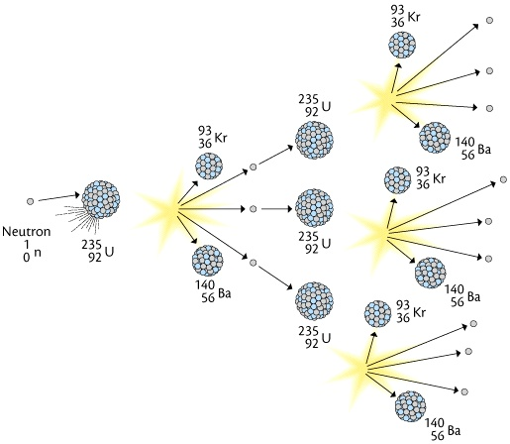
Chain reaction
Because 3 neutrons are produced from the reaction, the products of one reaction can start the reaction of 3 new fissionable atoms.
Because the natural abundance of U-235 is 0.7%, for natural uranium there is a limited chance that a neutron released will hit another fissionable atom.
Isotopic enrichment is required using highly specialized centrifuges that can distinguish the different isotopes of uranium.
The mass of U-235 required for a nuclear reaction to be sustained by the chain reaction is the critical mass.
Samples with a mass greater than the critical mass are used to make weapons.
Uncontrolled fission reactions are bombs. Controlled fission reactions are nuclear power plants.

Slide 8
Nuclear Fusion
In addition to Fission reactions, nuclear fusion also releases energy.
Note: All possible nuclear reactions go from less stable to more stable states with the release of some amount of energy. True for both natural decays and induced transmutations, including both fission and fusion reactions.
Fusion is the nuclear process the sun uses to create energy. (3-10x more than fission)
The H-bomb is an application of an uncontrolled Fusion reaction.
We have not yet learned how to maintain a controlled fusion reaction.
Why? Because Fusion requires a very high temperature to get the reaction to ignite.

Slide 9
Nuclear Fusion
In the sun, the process is three steps:
Two protons produce a deuterium, and a positron
A third proton collides with the deuterium to form helium-3 and a gamma ray
Two of the helium-3 nuclei collide to create a helium-4 nucleus and two extra protons.
The net reaction is
A Holy grail of nuclear research is to achieve this kind of fusion reaction at or near room temperature. So called “cold fusion”. (Cold here means something less than 10⁴ Kelvin. Even fusion at 100ºC would be considered cold.)
Fusion also doesn’t use fuel rods so it doesn’t create problematic nuclear waste from the spent fuel rods.
$$4{}_{1}^{1}{\text{p}→}{}_{2}^{4}{\text{He} +2 {}_{+1}^{0}e+energy }$$

Slide 10
Nuclear reactions
Fission: When a large atom is reacted with a neutron, it may form a nuclide that splits into two daughter nuclei.
Ex:
Fusion: When two small atoms collide to form a larger nuclide.
Ex:
Nuclides larger than Ni-62 may do fission. Smaller may do fusion.
The energy of nuclear reactions is also related to it’s mass changes.

Slide 11
Exit slip and homework
Exit Slip –
What’s due? (homework for a homework check next class)
p294 #18-24, except 23, Binding WS #6-8
What’s next? (What to read to prepare for the next class)
Read 7.1, 7.2

